Slide 1
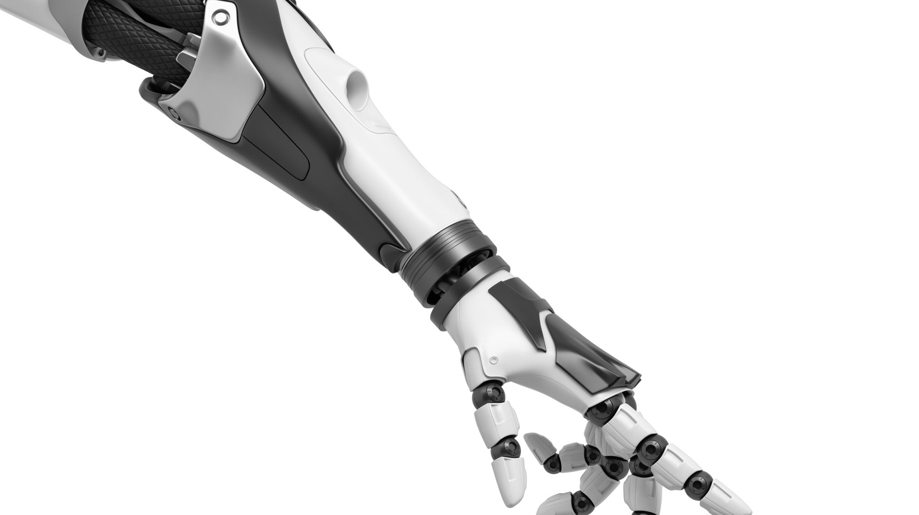
Intent Prediction Based on Biomechanical Coordination of EMG and Vision-Filtered Gaze for End-Point Control of an Arm Prosthesis
Upper Limb Prosthesis
Nili E. Krausz , Denys Lamotte , Iason Batzianoulis, Levi J. Hargrove , Silvestro Micera , and Aude Billard
Elad Siman Tov
Noa Cohen
Notes:
הנושא שנדבר עליו הוא פרוטזות לקטועי יד
מטרתו לבחון שיטת בקרה שתשפר את תפקוד הפרוטזה

Slide 2
Outline
Introduction
Methods
Results
Discussion
Background

Slide 3
Introduction – Arm prothesis
Restore arm function
High mental burden
Improve quality of life
Poor controllability
Lower mental burden
Intent prediction for end point control using EMG – Gaze sensor fusion
Notes:
Proposing a controller to interact with user intention to reduce mental burden.
How? “Intent prediction for end point control”.
Predicting intended arm end point with EMG and Gaze data
Control the arm joint trajectories by Inverse Kinematics.
בגלל המאמץ המנטלי וחוסר יכולת השליטה המלאה, יש נטישה של הפרוטזות אקטיביות (ממונעות) ולעתים כבר מעדיפים לחזור פרוטזות פסיביות
---
החוקרים התמקדו בפעולת פיק אנד פלייס
ורצו לחזות את מיקום האובייקט ומיקום היעד בעזרת חישת איאםגיי ומבט
הולכים להשוות את הביצועים של מבט עם איאמגיי ביחס ללא מבט

Slide 4
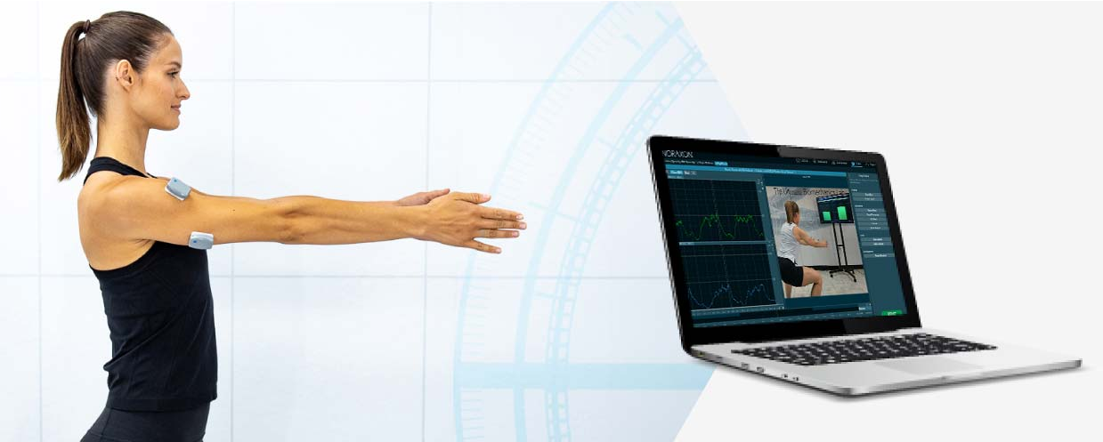
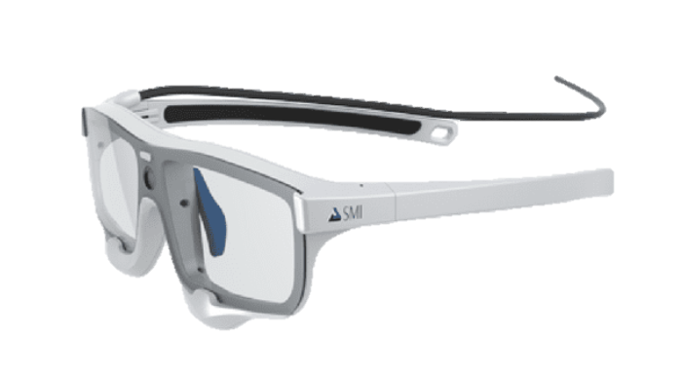
Estimating target position
SMI eye tracking glasses - SMI Eye Tracking Glasses – iMotions
EMG signals (14 muscles) - Surface EMG Systems | Noraxon Electromyography Solutions

Slide 5
Outline
Introduction
Methods
Results
Discussion
Background

Slide 6
Background – Myoelectric Control of Prosthesis
Idea
Using EMG signals for Prosthesis limbs control
Problem
Dimensionality mismatch (desired outputs > available inputs)
Solutions
Increase inputs (invasive, surgical)
Decrease outputs (PCA, Pattern classification, Regression)
Notes:
Solution 1 – still have limited inputs
Solution 2 – limited to 3 dof at a time and users cannot control each independent dof.
איך זה קשור? במאמר מראים שאפשר לצמצם את האווטפוטים על ידי שילוב של המבט של המשתמש מבלי לפגוע בביצועים.

Slide 7
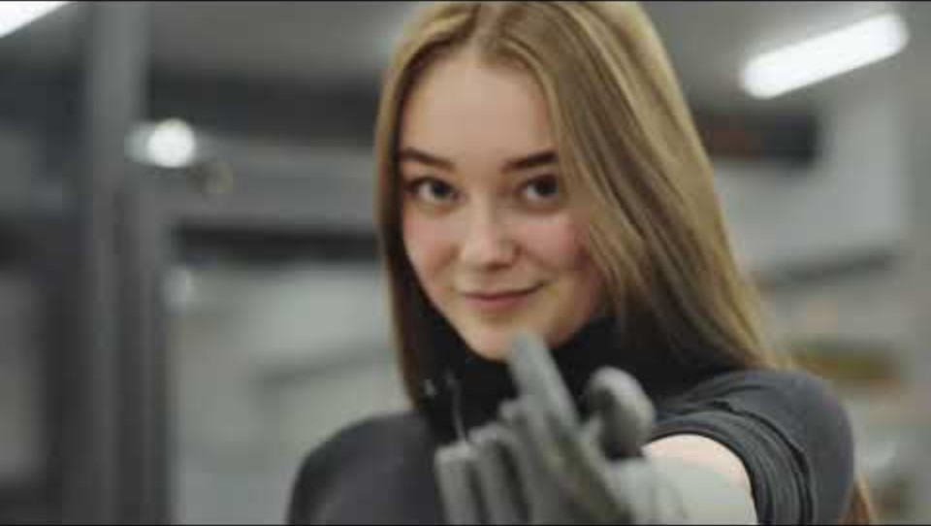
EMG controlled prosthesis example
Nika, Esper Bionics. EMG Signals + ML to classify user intent.
(Mental Burden).
Notes:
זו גם דוגמה למאמץ המנטלי שנדרש מקטועת יד כדי לבצע פעולה יומיומית.
היא צריכה למקם אותה, ורק לאחר מכן לסגור את היד, בעוד שאנשים רגילים לא חושבים על זה.
הרעיון הוא לנסות כמה שיותר להחליף את האדם בבקרה.

Slide 8
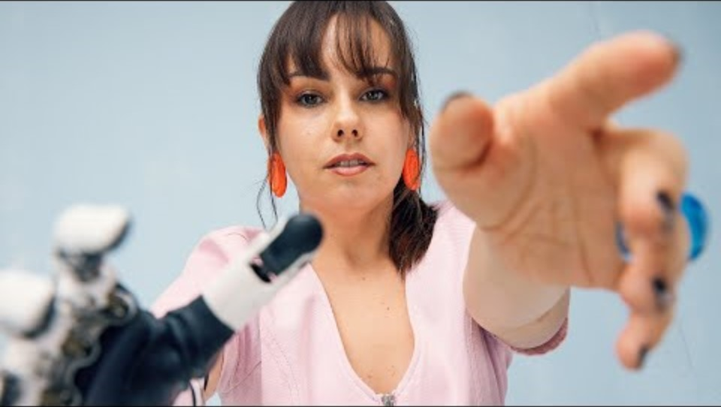
Appendix – Dimensionality mismatch

Slide 9


Background – Gaze Behavior during Pick and Place
Gaze?
Daily tasks are monitored by vision $∴$ Gaze tracking → Intent prediction
Pick and Place
Gaze fixations on object and target
Challenges
Distractions and random eye movement (Midas Problem), Head movement
Solutions
Gaze event detection algorithm and Image Processing
Notes:
Pick and place tasks involve gaze fixations, but not at the objects in hand. (locating, directing, guiding and verifying).
Many daily tasks that seem to be autonomous, are highly monitored by our vision. [30] Thus, gaze tracking is a compelling option for intent prediction.
Using gaze as a control input is hard due to unrelated / random eye movements (Midas Problem). But hand eye coordination correlations are used.
For a viable solution, an unrestrained head mounted gaze tracking system is needed. It is accompanied by head movement issues which requires solving
,נועות שאינן קשורות לפעולת פיק אנד פלייס

Slide 10
Appendix – Multi Modal Sensory Signal Fusion
Several signals can be used to detect user intent (EEG, ECoG, EMG)
Fusion of visual and motor signals result in more accurate and robust predictions.
The idea is to use natural signals to predict intent to avoid control burden on the user.

Slide 11
Outline
Introduction
Methods
Results
Discussion
Background

Slide 12

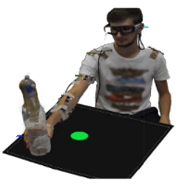


Experiment Pick and Place task
7 right-handed able-bodied subjects
TV with green dot
Pick and place a bottle
EMG, Gaze, Motion Capture
Notes:
להיכנס לקונטקסט
פיק אנד פלייס
אנשים ללא מגבלה
מדידות עיניים, איאמגי ומושן קפצ'ר

Slide 13
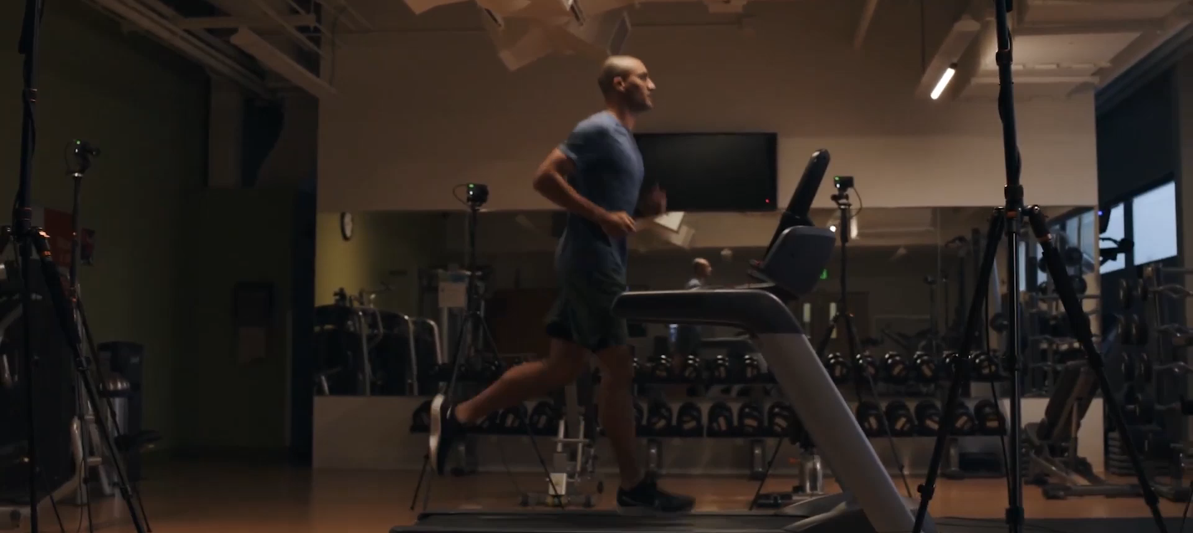
Ground Truth Estimation
Hand position - markers placed on shoulder and Hand (via OptiTrack - Motion Capture Systems)
Matching for EMG for regressor model.

Slide 14
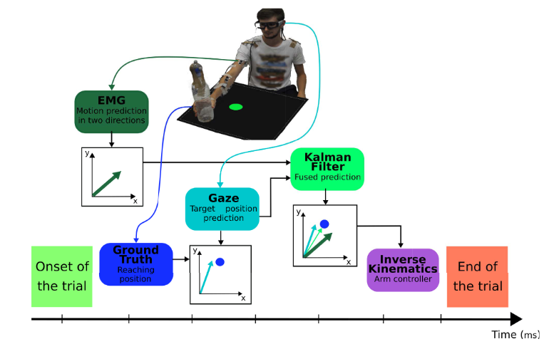

Slide 15
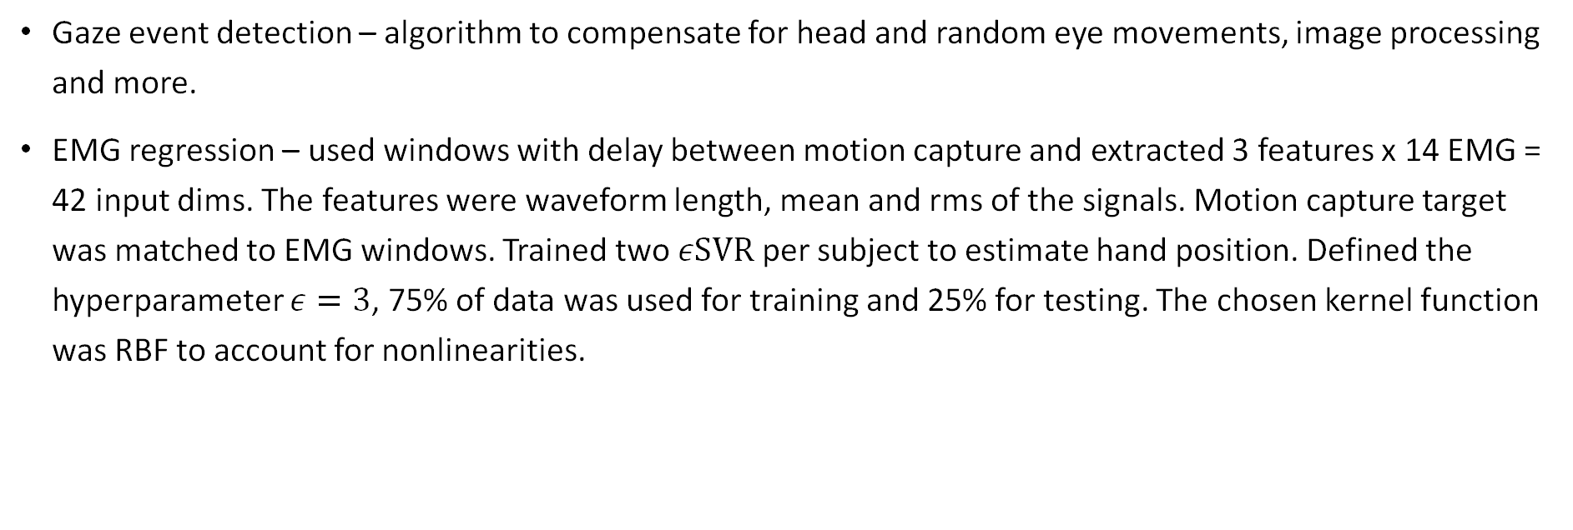
Appendix - Methods
Gaze event detection – algorithm to compensate for head and random eye movements, image processing and more.
EMG regression – used windows with delay between motion capture and extracted 3 features x 14 EMG = 42 input dims. The features were waveform length, mean and rms of the signals. Motion capture target was matched to EMG windows. Trained two $εSVR$ per subject to estimate hand position. Defined the hyperparameter $ε=3$, 75% of data was used for training and 25% for testing. The chosen kernel function was RBF to account for nonlinearities.

Slide 16
Outline
Introduction
Methods
Results
Discussion
Background

Slide 17

Results
Timing
Gaze on object → Grasp object → Gaze on end position → Object at end position
Gaze detection
Task related gaze events were detected 85.36%±7.5% of the time
EMG $εSVR$
RMSE x: 7.75 cm (testing) 5.51 cm (training) RMSE y: 4.03 cm (testing) 2.58 cm (training)

Slide 18
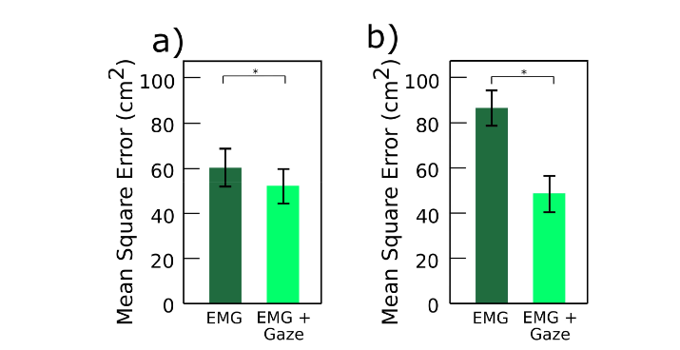
Fusion Performance
Entire motion
Target position

Slide 19
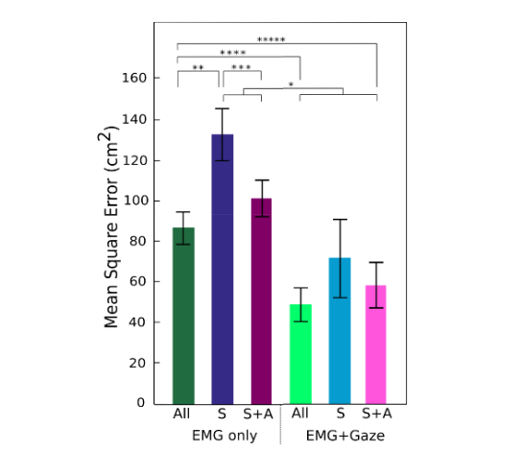
Simulated Amputation
↑ EMG ↓ Error
EMG only significance (All, S SA)
Addition of gaze significance
EMG + Gaze no significance
High level amputee importance

Slide 20
Outline
Introduction
Methods
Results
Discussion
Background

Slide 21
Discussion
Objective
New control system to assist amputees
Focus
Predict desired hand position during pick and place Coordination between Gaze and EMG
Future Work
Test with robotic arm in real time and an IK controller

Slide 22

Thank You !

Slide 23

Questions?

